Slide 1

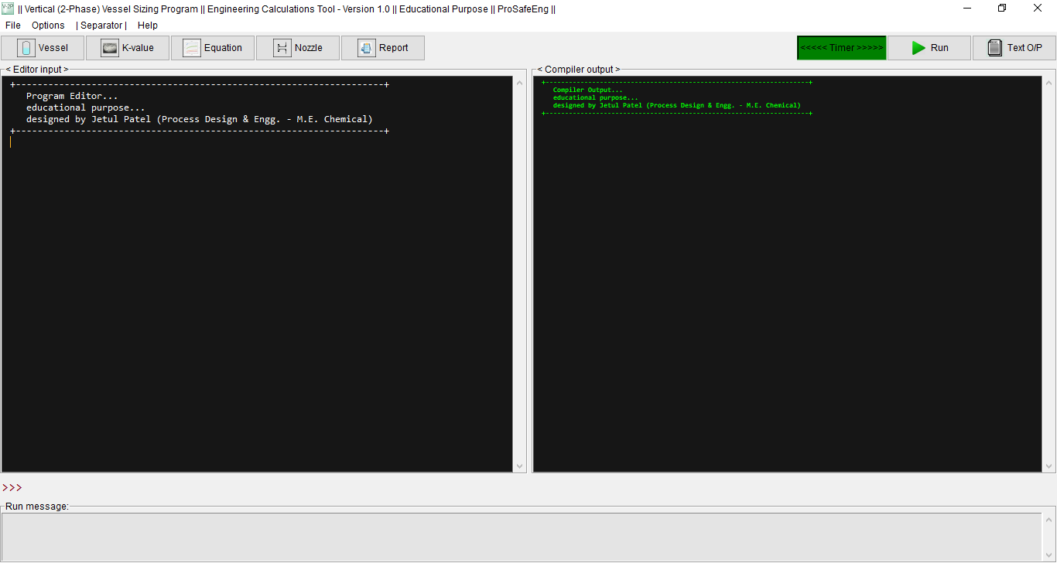
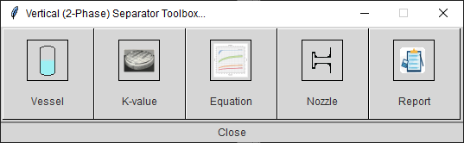
Develop calculation for 2-Phase Vertical Separator

Slide 2
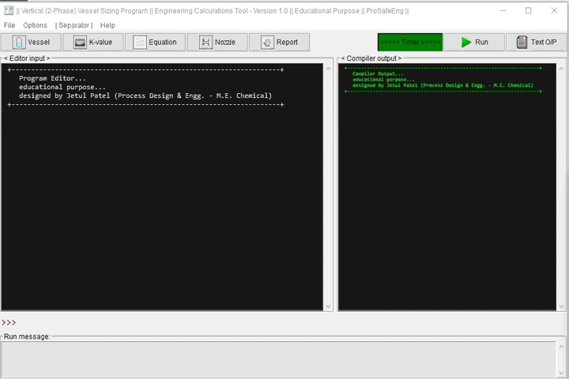
Play Video from PowerPoint V-2P.pptx file

Slide 3
About Developer
App programmed by JETUL PATEL - Calgary, AB
(Master’s & Bachelor in Chemical Engineering)
Verified International Academic Qualifications - Issued by World Education Services
https://www.credly.com/badges/1452ae0d-7f5a-469d-855e-4ccb21289752/public_url
Ongoing status (July 2022):
---------------------------
Engineer-in-training (E.I.T.) evaluation with APEGA is in queue (APEGA ID: 295914)
__________________________________________________________________________________
E: jetul.p.iichelm@gmail.com
LinkedIn: https://www.linkedin.com/in/jetul-patel-56910257/

Slide 4
About Developer
Process Design and Engineering Experience in the following:
__________________________________________________________________________________
Oil & Gas field development, Central processing facility (CPF), Gas processing, Oil gathering terminal, Pumping & flowline export pipeline, Multiphase pumping, Pigging facility, Gas sweetening, Dehydration, HC Dew pointing, Sour gas facility, Sales gas compression & metering, Brown-filed engineering, De-bottleneck study & modification/repair operation, SMR-hydrogen generation, CO2 removal unit, NGL facility, Refinery & Petrochemical, etc.,
Received certificates, as Recognition & Excellence for performing basic engineering activities for Hydrogen and Ammonia plants + CO2 removal unit critical equipment process sizing - issued by L&T
Disclaimer:
-----------
There are no competing interests regarding the design and program of this work.
Thank you!

